Slide 1
Sale of Federal Surplus Personal Property
APO Name Here
SCO Name Here

Slide 2
What is Personal Property?
Any property except real property and certain DoD vessels. Includes:
Office furniture & equipment
Medical equipment
Heavy machinery
Most vessels
Vehicles
Aircraft
Notes:
Speaker notes Real property definition

Slide 3
What are Excess & Surplus Personal Property?
Excess:
Property that is no longer required by the owning agency, but may be needed by another federal agency (as determined by the agency head or designee).
Surplus:
Property that is not needed by any federal agency, as determined by GSA.

Slide 4
Are agencies required to use GSA for property disposal?
Federal executive agencies
REQUIRED
Legislative & judicial
ENCOURAGED
See Federal Management Regulation (FMR) Part 102.36
Notes:
Federal executive agencies are legally required to report excess personal property to GSA for disposal (FMR 102.36), and must sell via an approved Sales Center or have a waiver.
Legislative & judicial branches are strongly encouraged, but not mandated. Check your internal policies for guidance on how to properly proceed with disposal.

Slide 5
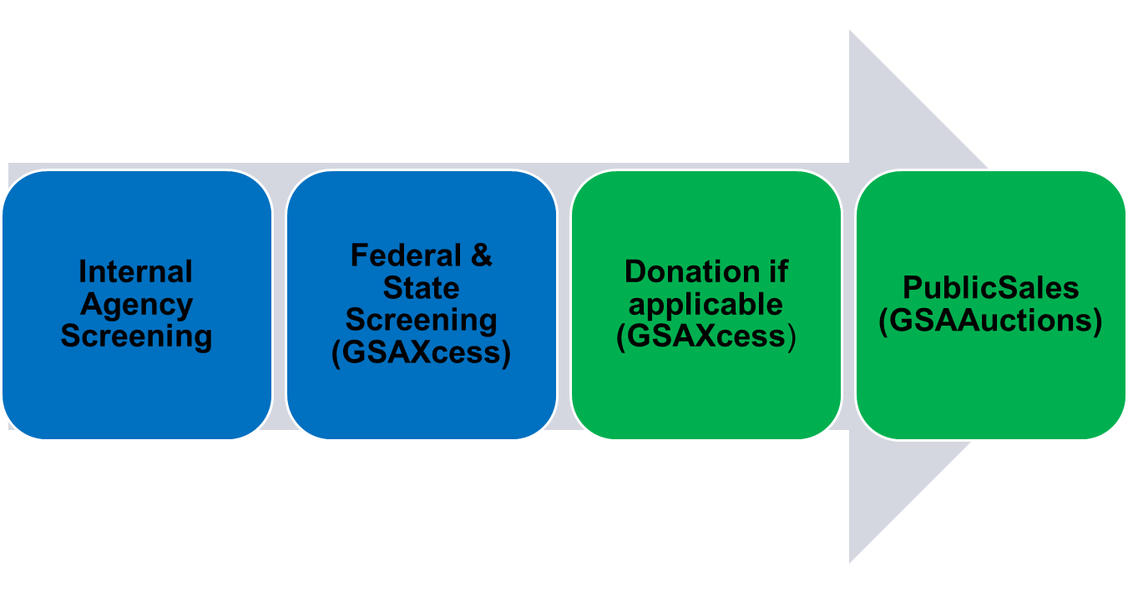
What is the Disposal Process?
Internal screening (redistribution)
Excess screening (federal transfers / Computers for Learning)
Surplus (Donation to public agencies (tax supported) & eligible non-federal entities)
Public Sales (GSAAuctions.gov)
Federal & State Screening (PPMS)
Donation if applicable (PPMS)
Notes:
Cover: When items become available for sale in the disposal process. This disposal process covers excess/surplus (including surplus reimbursable) property but does not apply to Exchange/Sale, Seized/Forfeited, and other authority property.
Timeline:
Internal Agency Screening: Depends on the agency/ commodity; 7-14 days
Excess: Depends on the commodity/ property type; 14-21 days
Sales Preparation: 10-14 calendar days
Auctions: 7-days
TOTAL Timeline: 30-60 days

Slide 6
What sales services does GSA offer?
There’s no upfront cost to use GSA!
We use proceeds from the sale to cover the
cost of sales!
Basic Services:
Sales preparation
Management of contract awards and disputes
Collection and distribution of proceeds
Prepare and send SF-97 to buyer
Reporting of annual sale data
Notes:
Stress the importance of effective listings (plain language, photos, etc) but if not, GSA will work with you to get them.
Description, quality photos, sale type (non-reimbursable / exchange sale), custodian info and inspection times.
With upset price - clarify “fair market value” in PPMS on reimbursable items
There’s no direct cost to use GSA - we use proceeds from the sale to cover.
Basic Services Offered (this is what the fee pays for):
Sales preparation (including description and listing, setting upset price)
Management of contract awards and disputes
Collection and distribution of proceeds
Reports annual sale data to OGP

Slide 7
What are the benefits of using GSA?
Compliant with the FMR
Warranted Sales Contracting Officers (SCOs)
Nationwide coverage
Reputable ecommerce platform, GSA Auctions
Digital marketing services
Optimizes return to the US Government
Eliminates removal costs
Diverts waste / promotes reuse
Notes:
Some benefits of selling used government property include additional disposal option; taxpayer benefits by getting surplus property at a great price and the government benefits by sell of surplus property.
Sales are conducted in compliance with the FMR by warranted Sales Contracting Officers (SCO).
Knowledgeable Sales representatives located across the U.S.
Reputable ecommerce platform (GSA Invests in digital marketing to increase awareness of the program and customer base).
Sales get worldwide visibility!
Optimizes return to the US Government.
Avoids removal costs and landfill disposal.

Slide 8
Does my agency receive reimbursement for sold property?
It depends on:
How the property was purchased,
If there’s a continuing need (Exchange/Sale), and/or
If the agency incurs and documents the cost of sale activities (e.g., storage fees)
Remember:
Reimbursable property must be identified when it’s reported and requires additional information (see Agency Reimbursement training for more information).
The Exchange/Sale Authority allows your agency to dispose of property it still has a need for. Proceeds from the sale of the old can be applied to the purchase of a similar item (see gsa.gov/es for more information)
Notes:
High Level Answer: It depends on how the property was purchased by the agency, if there’s still a need for the item, and/or if the agency chooses to document the cost of associated with all activities related to the sale.
See Agency Reimbursement training for more information.
Money not reimbursed is used to cover GSA overhead costs; any excess is sent to the treasury

Slide 9
What are the GSA Sales methods?
Primary Method: Internet (GSAAuctions.gov)
Accounts for about 99% of GSA Sales
Worldwide visibility and competition
Alternate Methods:
Sealed Bid
Term Contracts
Live Retail / Auction
Negotiated Sale at Fixed Price
GSA will work with your agency to determine the best method to use.
Notes:
What are the sales methods?
Over 95% of our auctions are posted online. It brings the greatest visibility and overall return.
The "offline" methods we use most are Term Contracts (has reoccurring removals over a set period of time. Typically for scrap metals or materials) , Sealed Bid and Fixed Price.
Sealed Bid/Term Contracts: Is there a recurring need for removal? Is there a specific/unique buyer required?
Live Auction: Ideal for agencies with a high volume of property and the need for immediate removal.
Fixed Price: Sales to a public body for Exchange/Sale Property. A Negotiated Sale at Fixed Price can be either to the SASP or directly to a Donee as long as the the SASP has confirmed that they are a public body.
Does the agency, or GSA, determine the sales method?
GSA will work with your agency to determine the best sales method to use.

Slide 10
What are the reporting agency roles and responsibilities?
Point of Contact (POC)
Also called the Reporting Official, this person should be available to answer questions about the property report. At the time of reporting the POC should provide:
A detailed and accurate property description
Clear photos of property (especially of key features)
Accurate Accounting Information (for reimbursable items only)
Include any special requirements for removal (e.g., clearance, COVID testing, etc)
Property Custodian
The person responsible for the property at its Property Location and who will receive a copy of the transfer order documentation. During the sales process, should:
Review & approve Invitation for Bid (IFB) and communicate changes to GSA in a timely manner
Facilitate inspections and removal
Safeguard, care and handling of property prior to removal.
GSA does the rest!
Notes:
Review accuracy & thoroughness of Invitation for Bid (IFB)
Be available during inspection and removal
Safeguard, care and handling of property prior to removal.
Answer questions from potential recipients about the property (be sure to note when the SCO should be involved)
Facilitate inspections or on-site screening (if applicable).
Maintain documentation of property records.
Properly store and protect assets while in screening or awaiting pickup.
Communicate any changes with GSA in a timely manner.

Slide 11
What is the Sales Process?
Lotted to a Sale
Review/Approve IFB
Awarded
Item(s) Paid
Item(s) Removed
Available in Sales
Internet Sale
When does this occur? After federal screening.
When does this occur? Within two weeks of becoming available. The SCO will send you a copy of the Invitation for Bid prior to offering sale.
When does this occur?
After you approve the IFB, the SCO will launch the sale for public bidding.
When does this occur? At the close of an auction (assuming the reserve was met)
When does this occur?
Bidders have 2 business days to pay. If paying via wire transfer, this may take longer.
When does this occur? Buyers have 10 business days to remove.
What happens?
Your item has completed screening in PPMS and has been sent to the sales team for processing.
What happens?
The SCO has assigned/lotted your item(s) to a sale. Once you receive the IFB, confirm the property is available, the description is accurate, and your availability during the sale.
What happens?
Auctions are generally live between 7 and 15 days.
What happens?
The successful bidder receives a notice of award via email.
What happens?
The buyer has completed payment and may now contact you to schedule removal. You will receive a copy of the purchaser’s receipt which contains the buyer’s information.
What happens?
Please notify GSA as soon as the buyer has removed. You should upload a copy of the SIGNED in PPMS to close out the record.
PPMS Status:
Available (in Sales)
PPMS Status:
Lotted
PPMS Status:
Lotted
PPMS Status?
Awarded
PPMS Status:
Sold (Paid)
PPMS Status: Removed
Check the current status using PPMS Manage Property (Available – Sold (Paid) status) or PPMS Search Property History (Removed).
Notes:
Sales:
Available for sale
Review Invitation for Bid (IFB)
Lotted to a sale
Internet Sale
Successful bidders list
Purchaser’s Receipt
Notify GSA of Pick up
Sales Process /
How can I check the status of my sale item?
Track your items with PPMS Manage Property
IFB: Confirm that the property is available, the description is accurate, and your availability duration of the sale. This must be done prior to the start of the sale.
Internet Sale:
-At the conclusion of an auction, a contract will either be awarded, or will remain in “lotted” status if there were no bids or the reserve was not met. If the reserve is not met, the SCO will reach out to you to see if you are willing to accept the current bid. If yes, an award will be made. If not, the item will more than likely be re-offered to the general public. If no bids, the item will go back into available status. The SCO and agency will determine if the item should be re-offered or returned for A&D.
At the conclusion, the auction will either be awarded, pending award (didn’t meet reserve), or ended with no bids.

Slide 12
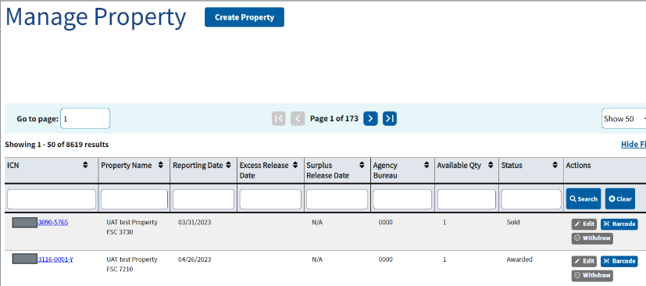
PPMS Manage Property
Notes:
Click on “Manage Property” under the “Property Functions” menu
Search the ICN field by Activity Address Code (AAC) or Item Control Number (ICN).
Click on Hyperlinked Item Control Number (this will take you into the property data sheet)
Scroll down to view the “Sales Details”
NOTE: If your item does not come up on the Manage Property page, try the Property History page (on Search Property)

Slide 13
Will GSA notify me of changes in sale status?
Watch your email for these notices:
Notification | When? | Who? | Why?
Available for Sale | Day 1 | Agency POC and Custodian | Let’s you know your item has finished screening and is eligible for sale
Invitation for Bid (IFB) | Within two weeks of being available | Custodian | You will need to review and approve all details relating to the sale and description.
Purchaser’s Receipt | Sent once the successful bidder pays | Custodian, ALC POC | Contains buyer’s information for coordinating removal as well as financial data for reimbursement.
Return Disposition Letter | Anytime during the sales process, but most commonly after a first attempt to sell. | Agency POC | Your item has no market value or is too hazardous to sell. Your agency is responsible for ultimate disposition.
Notes:
What can I expect when my property is available to sell?
IFB: Confirm that the property is available, the description is accurate, and your availability duration of the sale. This must be done prior to the start of the sale.
How does the agency know when a sale has . . .
Closed – sold:
Closed – not sold
Been paid for: You will receive a copy of the purchaser’s Receipt.
Sold but defaulted for non payment
Discuss the related emails/notifications
Answer: What action does my agency take for each of the above?

Slide 14
What if my property doesn’t sell or the buyer defaults?
Not every sales goes to plan!
Possible Outcomes:
No Bids (no interest in/market for the property)
Buyer Default (buyer either didn’t pay or remove the property)
Cancellation (the SCO cancelled the initial awarded contract)
Possible Remedies/SCO may:
List for resale (if appropriate)
Offer to next highest bidder (if appropriate)
Return to the agency for ultimate disposition
(consider A&D; check with National Utilization Officer for guidance on internal policies)
Notes:
Ideal Process: An award was made and the property was paid for/removed.
Deviations:
No Bid: No market for property (consider Abandonment/Destruction A&D).
Default: An award was made, but the buyer either didn’t pay or remove the property (may be reposted for sale or returned to the agency for A&D).
Cancellation: For whatever reason, the SCO cancelled the initial awarded contract (may either be awarded to next highest bidder; reposted for sale; or returned to the agency for A&D).
You can read more about A&D here (include link to FMR)
Contact your National Utilization Officer (NUO) for internal guidance on A&D procedures - most agencies have additional internal policies – always check!)

Slide 15
When can I release sold property?
The buyer must present a paid receipt entitled “Purchaser’s Receipt and Authority to Release Property” at the time of removal:
If the buyer is removing, they must present you a government-issued photo ID.
If a 3rd party is removing on behalf of the buyer, they must present an authorization memo and government-issued photo ID.
They must sign the purchaser’s receipt and leave it with you as proof that the property was removed.
Notes:
Verify the government-issued photo ID matches the purchaser’s receipt / authorization memo
Send the signed receipt to your SCO

Slide 16
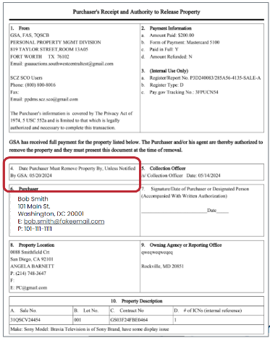
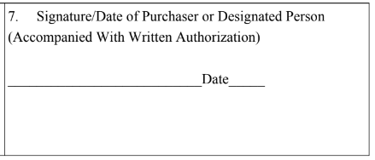
Purchaser’s Receipt Example
Once the buyer has signed the receipt and removed the property, upload the signed receipt in PPMS!
Notes:
APOs can point out 2D. In a single item lot, 2D will display the Item Control Number for most commodity types (specialty FSCs, like aircraft, may not have the ICN listed). Multi line items will say “multi line item” only

Slide 17
What are the buyer’s responsibilities?
Pay for the property within 2 business days.
Remove property within 10 business days.
The buyer has 10 business days from the date of award to remove property. If an extension is needed, the buyer must contact the SCO.
Arrange and pay for complete removal, including:
All tools & personnel required for disassembly (if required), packing, and removal.
Packing, shipping and transportation costs
Packing &
Shipping Co.
Notes:
Only the SCO can grant a pickup extension
Discuss pickup options for small items:
-agency should not be packing items with bidder-provided shipping labels
-bidders can arrange for a packing/shipping to come to the site and package the item

Slide 18
What if the buyer doesn’t pick up the item?
Notify your GSA SCO, who will discuss options with you:
Grant an extension
Default the bidder
Partial removal is considered non-removal - we still want to know!
Notes:
Emphasize again: ONLY the SCO can grant an extension

Slide 19
Terms & Conditions: Removal
Bidders can’t bid unless they agree to the Ts & Cs, which include removal conditions!
Notes:
Link to Ts & Cs: https://gsaauctions.gov/html/static/terms.htm

Slide 20
Claims of Misdescription:
If a purchaser feels an item is not as described, they can submit a claim for misdescription (time limit of 15 days).
If a customer contacts you (the custodian), please direct them to the SCO!
.
Common misdescription complaints:
Condition (not guaranteed)
Incorrect year of manufacture
Mileage is off by more than 500
Incorrect manufacturer
SCO will:
Review claim with custodian
Analyze against the Terms and Conditions (T&C)
Respond / rectify
You can help prevent misdescriptions by reporting accurate information about your property.
Notes:
Image explanation: everyone cries if we have to process/ review a misdescription claim! (joke)
If a customer feels an item is not as described, they can submit a claim for misdescription.
Submitted in writing within 15 calendar days: From date of award: Awarded, not paid; From date of email payment: Awarded, Paid, Removal may or may not have taken place. i.e., Incorrect year, mileage off more than 500 miles, wrong manufacturer, etc. Most claims submitted on the item’s condition, which is not guaranteed.
SCO will verify claim with custodian Analyze against T&C, Respond

Slide 21
PPMS Demo:
Finding Your Items
Office of Personal Property Management
Notes:
APO should demonstrate how to use property inquiry to search by AAC to find items (and view sales status/ SCO information)
AACs to use: poll audience for their AACs to pull up live records (interactive)

Slide 22
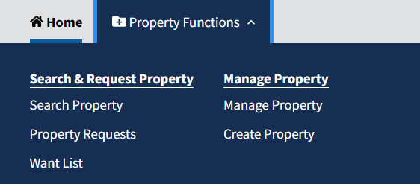
Find your active property listings
Notes:
Go to property functions > Manage property

Slide 23
Use filters to find your active items
Notes:
Once on manage property, all property listings in screening (internal/ excess) or actively in sales that you either reported or are associated with will display. You can sort by item name, report date, SRD, item status or ICN.
Statuses are included in the appendix but NEW in PPMS are your draft records. Drafts are kept for 30 days before deletion.

Slide 24
My item is “in Sales” but is it “on Auctions”?
Click the ICN and scroll to the bottom of the data sheet for Sales details
Questions? Contact your GSA POC!
Notes:
If your item is in Sales versus requested, the bottom of your item’s data sheet will have a sales widget that will update as it moves through the sale process. A complete list of sales and contract statuses can be found both at the end of this deck and on the FAQs page at the top of PPMS.

Slide 25
Questions?
Office of Personal Property Management

Slide 26
Contact Us: Specific Property Questions
If your item:
Is not in sales yet, contact your GSA Area Property Officer
Has rolled to sales, but hasn’t been lotted yet, contact the SCO or Sales POC listed in PPMS.
Has been lotted or sold, contact the SCO listed in PPMS.

Slide 27
Contact Us: General Questions
For questions on:
Property disposal, contact your GSA Area Property Officer
Sales, contact your GSA Zonal Sales Office
For access to PPMS, contact your National Utilization Officer
Other Resources:
Property Custodian Guide
Agency Reimbursement Slides
Abandonment & Destruction Slides

